Slide 1

Learn. Imagine. Build. .NET Conf
.NET Core Microservices on
Azure Service Fabric
Maxime Rouiller
@MaximRouiller

Slide 2

Cloud Developer Advocate
@MaximRouiller
Hashtag: #azdev
Hi!

Slide 3
What you will learn from this session
What is a microservices architecture and why is it relevant?
What is Service Fabric?
How to get started with microservices using .NET Core and Azure Service Fabric?
How to unleash the power of your microservices application?
Where does containers fit in? And should I?

Slide 4
Why a microservices architecture?
Provides long-term agility by Enabling better maintainability in complex, large, and highly-scalable systems. Letting you create applications based on many independently deployable services that each have granular and autonomous lifecycles.

Slide 5


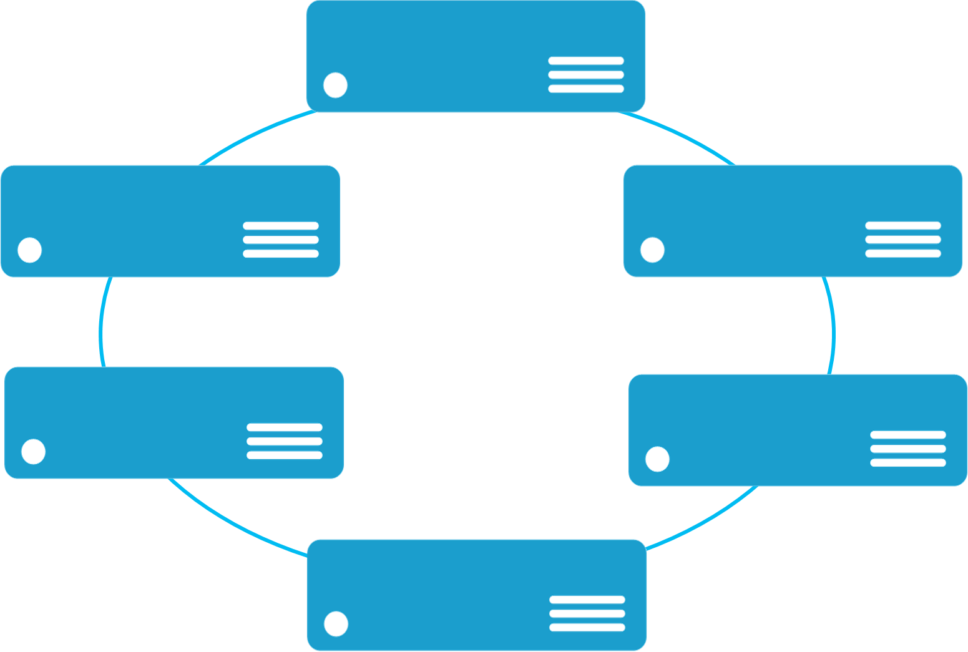


Monolithic application approach
Microservices application approach
A monolith app contains domain specific functionality and is normally divided by functional layers such as web, business and data
App 1
App 1
App 2
A microservice application separates functionality into separate smaller services.
Scales by cloning the app on multiple servers/VMs/Containers
Scales out by deploying each service independently creating instances of these services across servers/VMs/containers

Slide 6
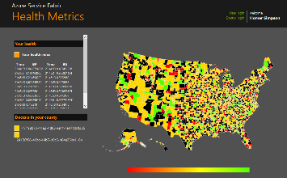
State in Monolithic approach
State in Microservices approach
Single monolithic database
Tiers of specific technologies
Graph of interconnected microservices
State typically scoped to the microservice
Variety of technologies used
stateless presentation services
stateless services
stateful services
stateless services with
separate stores

Slide 7
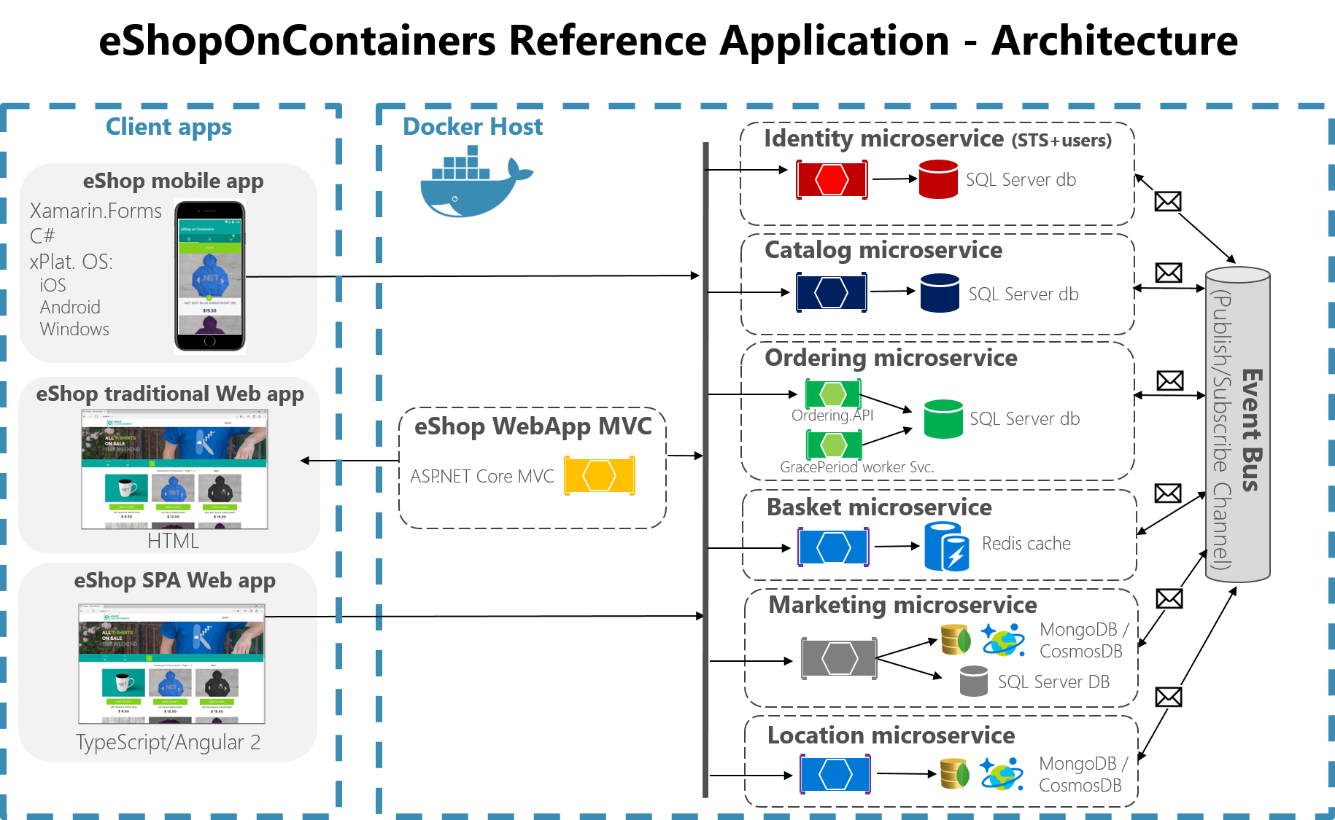

Slide 8
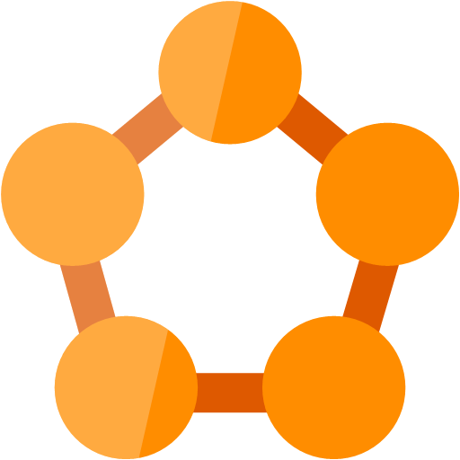
Service Fabric makes it easy
Rolling Upgrades
Availability Guarantees
Scale Out Architecture
Resource Governance
Density
Policy Enforcement
Stateful Workloads
Azure
Service Fabric
Integrated Solution
Azure’s Microservices platform

Slide 9

Service Fabric Cluster in Azure
Cluster supports 1,000s of nodes
is self repairing, and scales-in and out
Datacenter (Azure, On-Premises, Amazon)
PC/VM #2
Service Fabric
Your code, etc.
PC/VM #3
Service Fabric
Your code, etc. (Port: 19080)
Your code, etc.
Service Fabric
PC/VM #1
PC/VM #4
Load Balancer
Your code, etc.
Service Fabric
Your code, etc.
PC/VM #5
Web Request (Port: 80/443/?)
Service Fabric
Your code, etc.

Slide 10
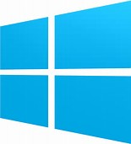


Azure Service Fabric
Any OS, Any Cloud
containers and microservices
Lifecycle
Management
Always On Availability
Programming Models
Health & Monitoring
Dev & Ops Tooling
Auto
scaling
Orchestration
Dev Machine
Azure
On Premise
Infrastructure
Other Clouds
Notes:
Runs on any OS and any cloud
Service Fabric sites on your
-dev machine
-azure
-On premise infra
-other clouds
Your application sits on top of that

Slide 11
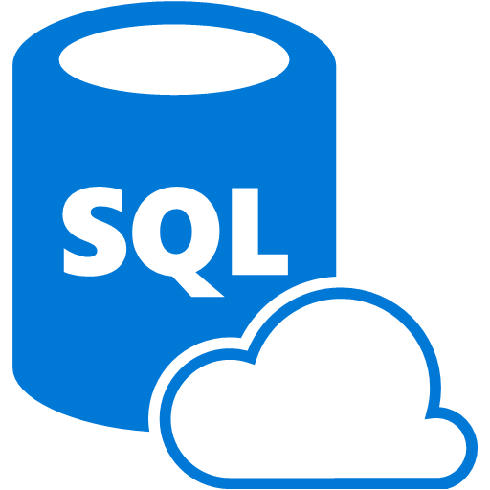



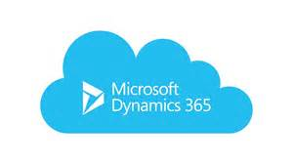

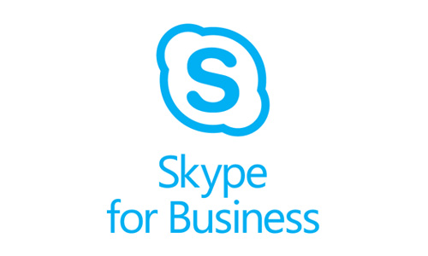

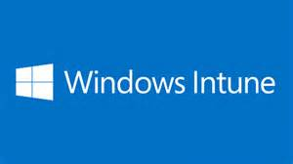
Services Powered by Service Fabric
Cosmos DB
Billions transactions/day
IoT Hub
Millions of messages
Event Hubs
60bn events/day
SQL Database
2.1 million DBs
Skype
Cortana
Intune
Dynamics
Power BI
Notes:
Runs Azure
This runs critical software.

Slide 12
Demo:
Getting Started with a simple application

Slide 13
Demo:
Upgrading

Slide 14
Path to microservices
Some options to consider:
Use a “monolith” if you can
Start with a monolith and peel off services
Start with a small number of coarse-grained services
Go with containers and apply options 1-3

Slide 15
Containers and Orchestration

Slide 16

Container images
Image Contents
Registry
Folders and Files
My Website
Application
HKLM
inetpub
mysite.html
IIS
SOFTWARE/mykey
Application Framework
Image Contents
Registry
Folders and Files
HKLM
HKCU
License.txt
PerfLogs
Program Files
Base Image (OS)
HKCR
HKU
Program Files (x86)
Users
Windows

Slide 17
Service Fabric and Containers
Image deployment and activation
Support for authenticating with private registry
Environment variables to provide inputs to the container
Volume driver support
Mounting of persistent volumes drives
Networking
Bridge network: Mapping of container ports to dynamic ports on host machine
Registration of container endpoints with the Naming Service for communicating between containers
DNS service within cluster to resolve container endpoints
Resource governance
Apply policy on containers for resource constraints and use them during placement. CPU, memory, I/O
Process constraints: Extending constraints and governance to processes
Support for Docker Compose
Dv3
Ev3
New generation of D family
High memory

Slide 18
How does it look?

Slide 19

ASP.NET Core + Service Fabric
Service Fabric
Web API back-end service
MVC web application
Web API back-end service
Web API front-end service
Web API back-end service

Slide 20
Hosting ASP.NET Core in Service Fabric
In a Container
As a Guest EXE
Hosted in a Reliable Service

Slide 21
ASP.NET Core WebHost
WebHost in a single process, like a guest EXE
Host process
Server
Kestrel or WebListener
Program Main()
ASP.NET Core WebHost
Create
Application
MVC, etc

Slide 22
ASP.NET Core WebHost in Service Fabric
WebHost in a Reliable Service
Service host process
Program Main()
Service instance/replica (multiple)
Register
service type
ASP.NET Core
Service Fabric runtime
Server
Kestrel or WebListener
Create
ICommunication-Listener
ASP.NET Core WebHost
Create
Application
MVC, etc

Slide 23


Slide 24
Try it!
Service Fabric developer SDK
https://aka.ms/ServiceFabricSDK
Learn from samples, free clusters and labs
https://aka.ms/ServiceFabricSamples
https://aka.ms/TryAzureServiceFabric
Questions? Comments? Issues?
https://stackoverflow.com/questions/tagged/azure-service-fabric
https://aka.ms/ServiceFabricForum
https://github.com/azure/service-fabric-issues

Slide 25
Thank you!
Twitter: @MaximRouiller
Feedback: marouill@microsoft.com
https://aka.ms/SFDocs

